Slide 1
Ted Talk
Kindness

Slide 4
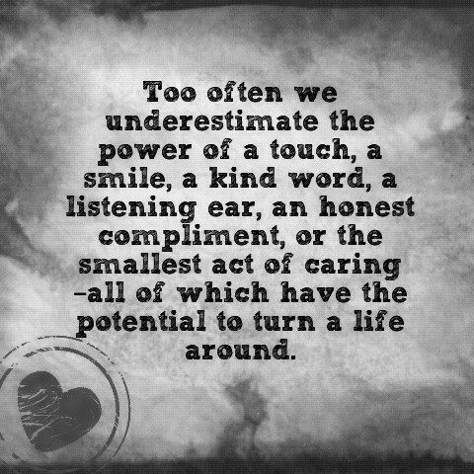

Slide 5
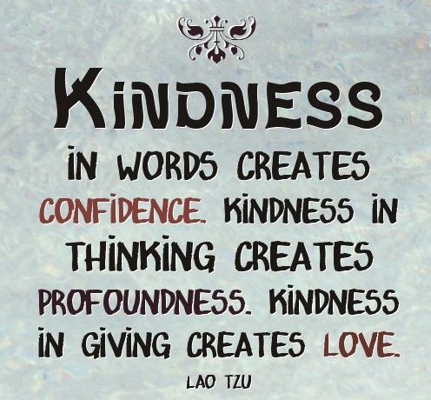

Slide 6
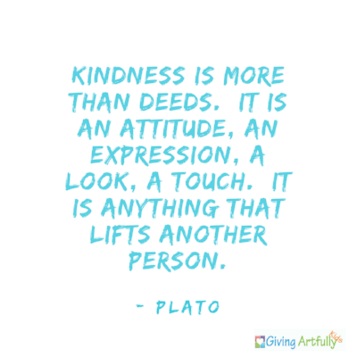

Slide 10
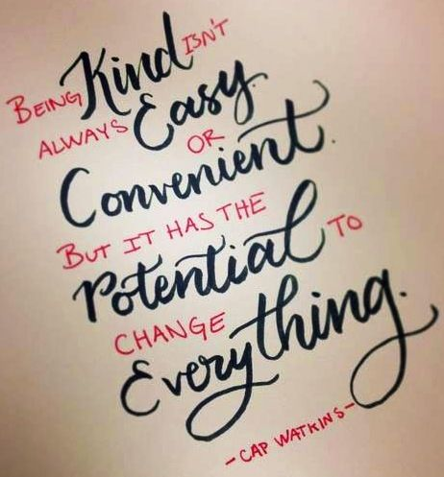

Slide 11
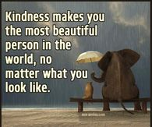

Slide 14
Tell me about a book that you read

Slide 15
Feel Happy

Slide 16
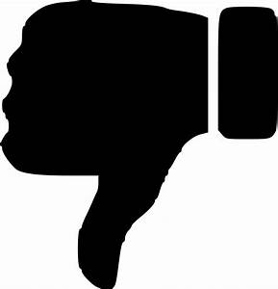
Ted Talk
Can money buy happiness?

Slide 17
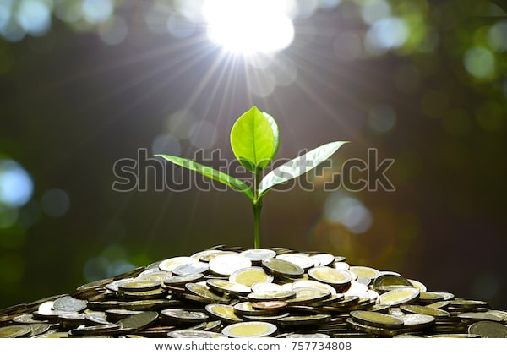

Slide 18
Sometimes more cash is what you really need.
Money, riches, fame. All things plenty of us dream about having one day. They can all do so much for you and can seemingly get you anything and into anywhere. If you have the cash, you can do it.
But, with desires such as these, the age old question rises to the surface — can money buy happiness?

Slide 19
Money can change a person’s feelings pretty quickly.
“...it is a fact that money exhilarates people, it puts them in hysterias of good cheer, they suddenly care about you and want the best for you.”

Slide 20
Money is a problem solver.
“They say money can’t buy happiness. But it can sure as hell solve a lot of problems!”

Slide 21
Part of the joy it brings is in the way you got it.
“Happiness is not in the mere possession of money; it lies in the joy of achievement, in the thrill of creative effort.”

Slide 22
Though the best riches can be found within.
"Happiness resides not in possessions, and not in gold, happiness dwells in the soul... By desiring little, a poor man makes himself rich."

Slide 23
"A wise man should have money in his head, but not in his heart."

Slide 24
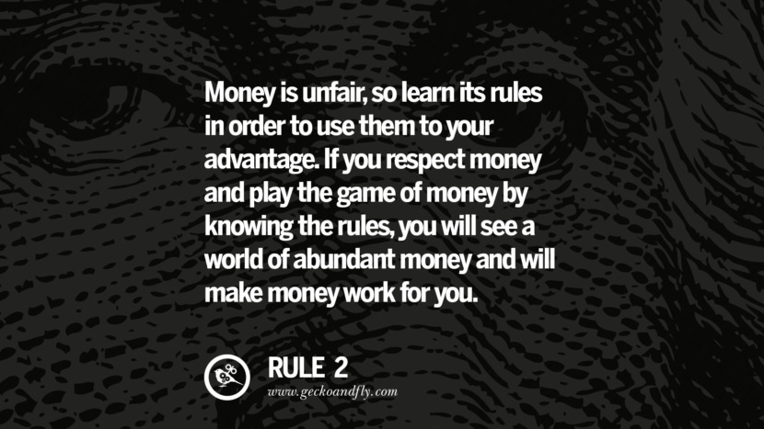

Slide 25
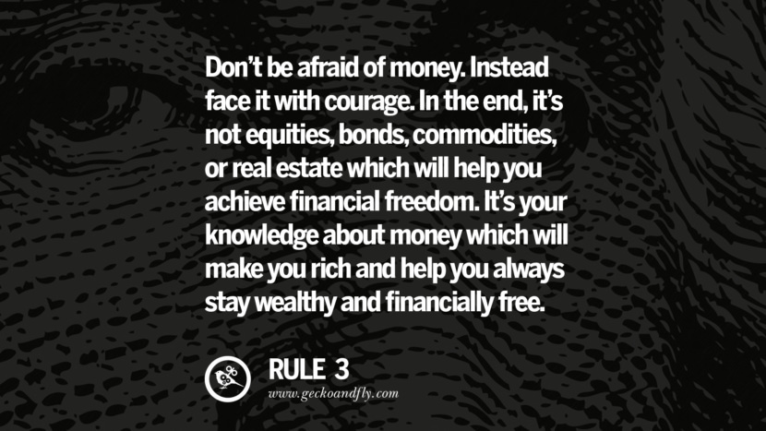

Slide 26
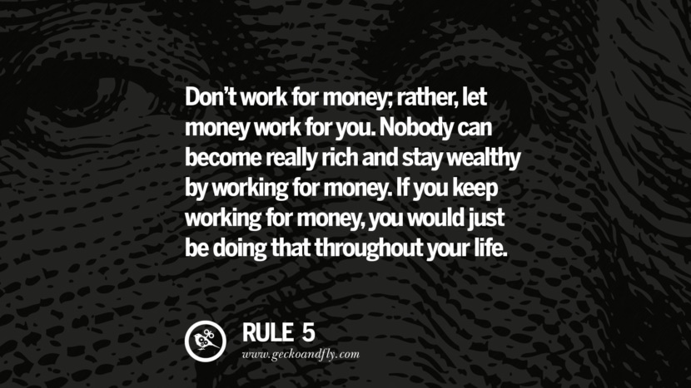

Slide 27
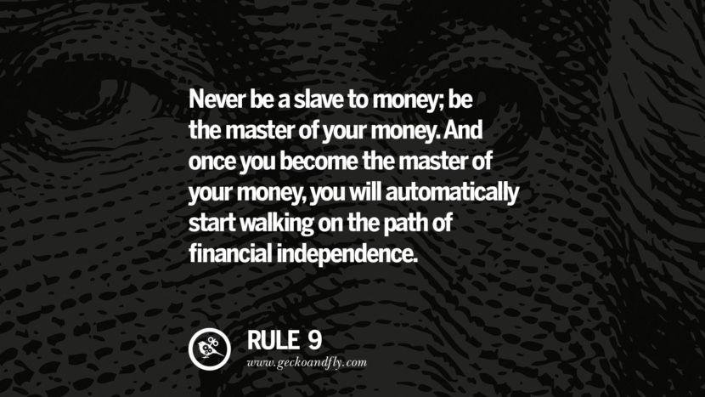

Slide 28
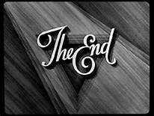

Slide 29
Stay at home. Be safe

Slide 30
Speech
Ted Talk
Tell me about a book that you read
Vocabulary Competition

Slide 31
Ted Talk

Slide 34
