Slide 1
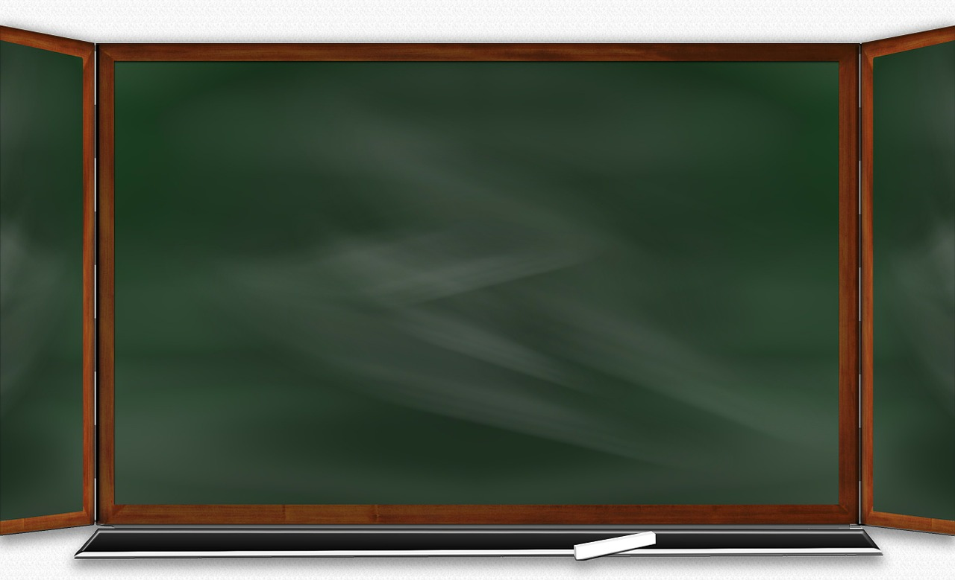
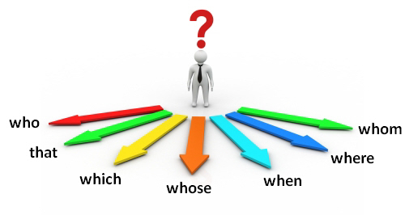
O
B
J
E
C
T
I
V
E
s
Ihsane High School
English Course
Module8

Slide 3
Examples

Slide 7
Exercise

